Slide 1
Before You Start
DCA Protected Best Practice Inventory: Core Competencies first item!
“Does your municipality maintain an up-to-date municipal website containing at minimum the following: past 3 years’ adopted budgets; the current year’s proposed budget; most recent financial statement and audits; notification(s) for solicitation of bids & RFPs; and meeting dates, minutes, and agendas for the governing body, planning board, board of adjustments & all commissions.”

Slide 2
Website Content, Accessibility, & Management 2.0
Managing a redesign with an outside firm
By Amy Spiezio, MA
Managing Editor, NJ Municipalities, NJLM

Slide 3

Time to Make a Change?
Design
Staff
Plans for the Future
Is the Pain Worth the Pain?

Slide 4

Getting Internal Agreement
Department outreach
  Who is working on site?
  Interest in upgrade/update
Needs & wants
  Realistic expectations
  No expectations!
Determine benefits of change
  User issues
  Increased technology expectations

Slide 5
What We Wanted
In-house control
Consolidated services for blog, newsletters
Updated look and functionality
A forward-looking partner. Someone to give us what we didn’t know we needed

Slide 6
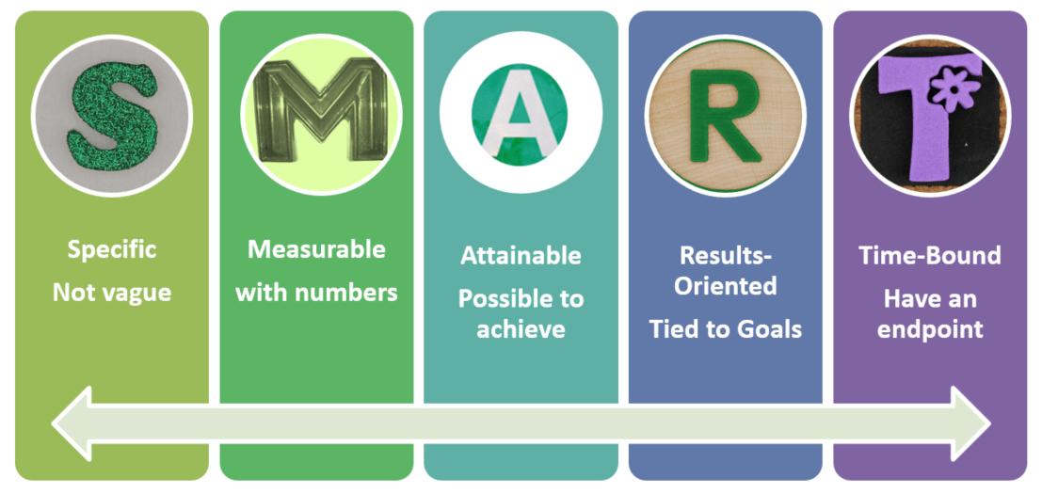
This May Take A While
SMART pitching
  Specific: Ugly ain’t going to make it happen.
  Measurable: Complaints, bounce backs, 404s
  Achievable: Local Government vs. Big Business
  Relevant: Personnel and audience factors
  Time Bound: Length of project & current expectations/timeliness
  * If at first you don’t succeed, pitch, pitch again!

Slide 7
Meeting Your Match
Size
Location
Open/Closed system
Webmaster or not, internal or external control

Slide 8
The Big Dig
Many, many fish in the web design ocean.
Form a research committee.
Interview candidates, but be realistic about how many interviews you want to do.
Be realistic about what you want within your budget and resources.
Organize your information.

Slide 9
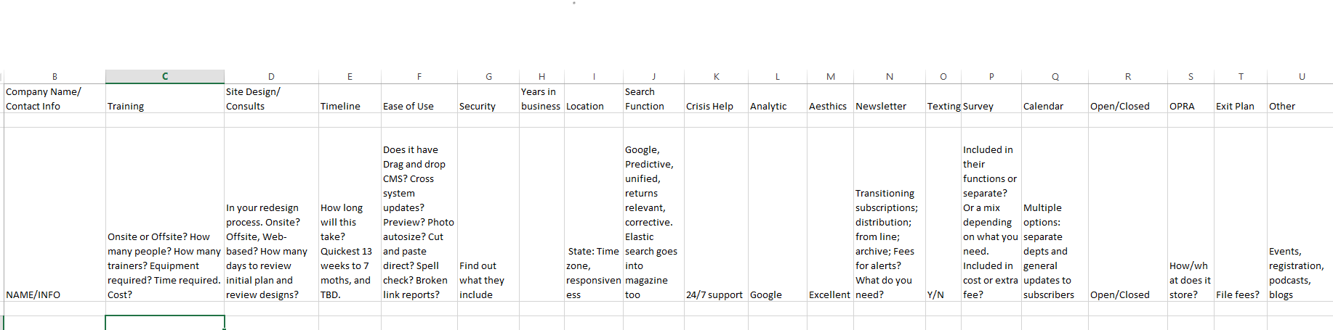
Chart Your Future

Slide 10
Considerations: Ease of Use
Drag and drop CMS to build pages moving forward?
Cross system updates?
Preview before designed pages go live?
Photo autosize?
Cut and paste directly from Word to CMS?
Spell check?
Broken links reports?

Slide 11
Considerations: Search Function
Google
Predictive
Unified
Elastic
We just wanted better!

Slide 12
Considerations: Tools
Newsletters
Texting
Surveys
Calendars
OPRA (how & where)
Events
Podcasts
Blogs

Slide 13
Considerations: Training
  Onsite or offsite?
  For how many people?
  How many trainers?
  Equipment required? (laptops, Ethernet cables)
  Time required?
  Costs?

Slide 14
Considerations: Crisis Help/Support
Emergencies
  24/7 support?
Everyday
  Help desk
  Support team
  Guaranteed response time?

Slide 15
Consideration: Exit Plan
How much is it going to cost to get out of here?
File Fees
Contract length
Transfers

Slide 16
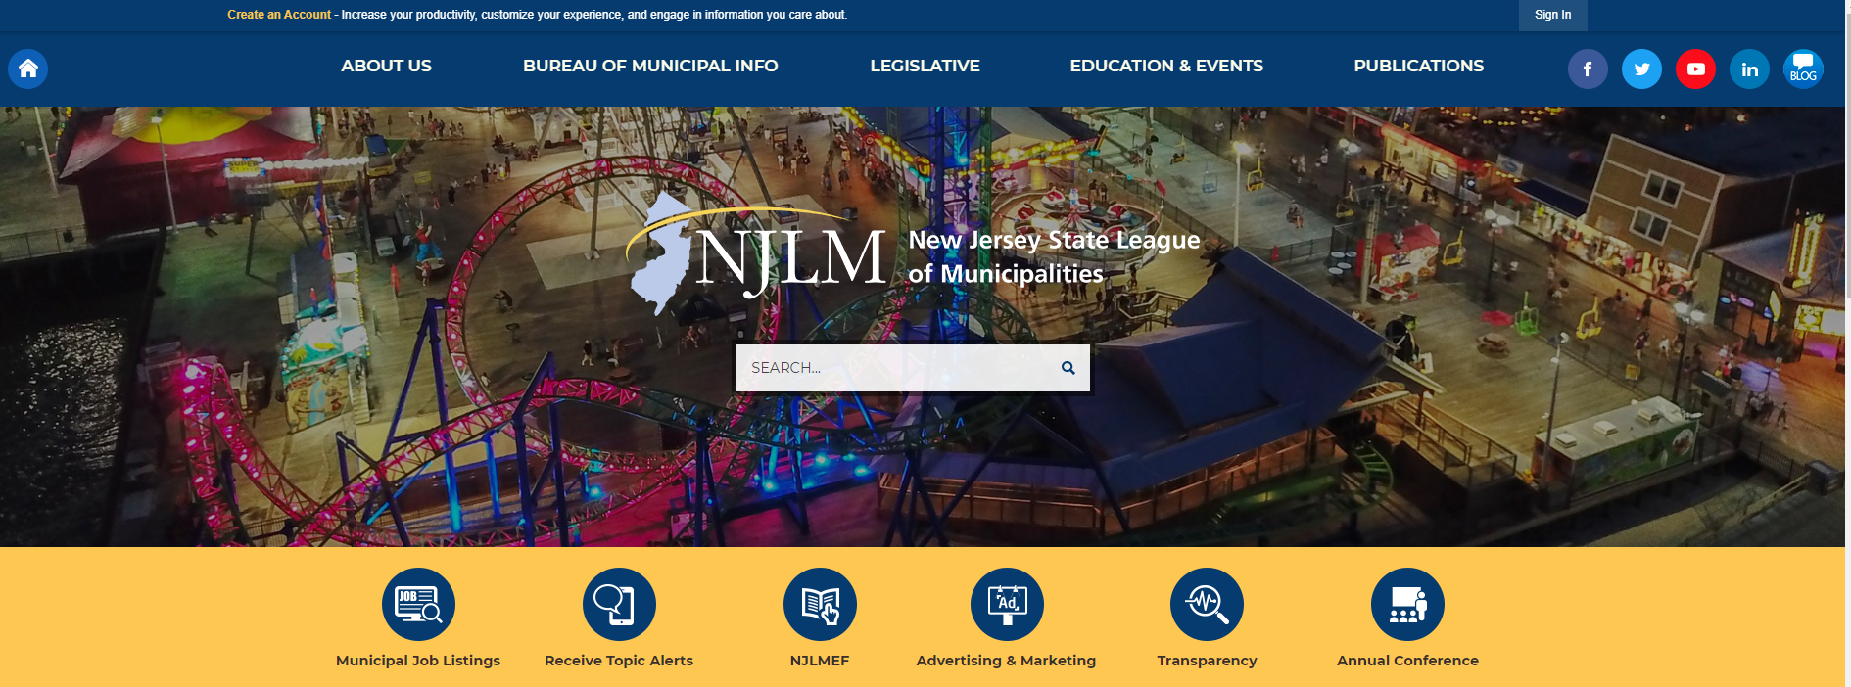
Consideration: Aesthetics
Looking good!

Slide 17
Considerations: Timeline
How long will this take?
  Promises, promises: 12 weeks to 7 months or the dreaded TBD!
  Consider your schedule. This Conference shifted our go live date by about six months.

Slide 18
Considerations: Design/Consults
  During your redesign how will you stay informed about the process?
  Is this via phone, in person, web based?
  How many days do you have to review the plans they present to you? Build in time for yourself. Don’t allow yourself to be rushed.

Slide 19
Managing the Project
Teamwork!
  Value of having a good cop and a bad cop
  Tech expert and content specialist
Timelines!
  They want their money
  You have your needs
Expectations!
  For better and for worse

