Slide 1
NJ Cares Initiatives
Impact on Municipalities
Sharon joyce, AAG
Director of nj cares

Slide 2
NJ CARES
OFFICE OF THE NEW JERSEY COORDINATOR OF ADDICTION RESPONSE AND ENFORCEMENT STARTEGIES

Slide 3
Opioid Overdose Overview
Prescription and illegal drug overdoses are now the number one cause of accidental death in the nation, surpassing car accidents.
Opioids including heroin, fentanyl-class compounds, and prescription drugs are the most common drugs involved in fatal overdoses.
Overdose deaths/drug related deaths increased from 1,587 in 2015, to 2,221 in 2016, to 2,750 in 2017 (preliminary). From January 1, 2018 through November 4, 2018, there have been 2,597 suspected overdose deaths.

Slide 4
Fentanyl
Fentanyl and its class compounds are known for having a potency up to 10,000 times that of morphine.
In the state of New Jersey, suspected heroin submissions containing fentanyl class compounds have steadily increased; fentanyl adulterated drugs are responsible for an increasing number of deaths in the state.
Fentanyl has been found in all 21 counties in New Jersey.
Fentanyl involved deaths increased 209% from 2013 to 2014 (46 to 142); 194% from 2014 to 2015 (142 to 417); and 135% from 2015 to 2016 (417 to 982).
Statewide, in 2016, 44% of all drug related deaths involved fentanyl.

Slide 5
Naloxone administrations increasing
2015
2016
2017
7,227 naloxone administrations statewide.
10,308 naloxone administrations statewide.
14,356 naloxone administrations statewide

Slide 6
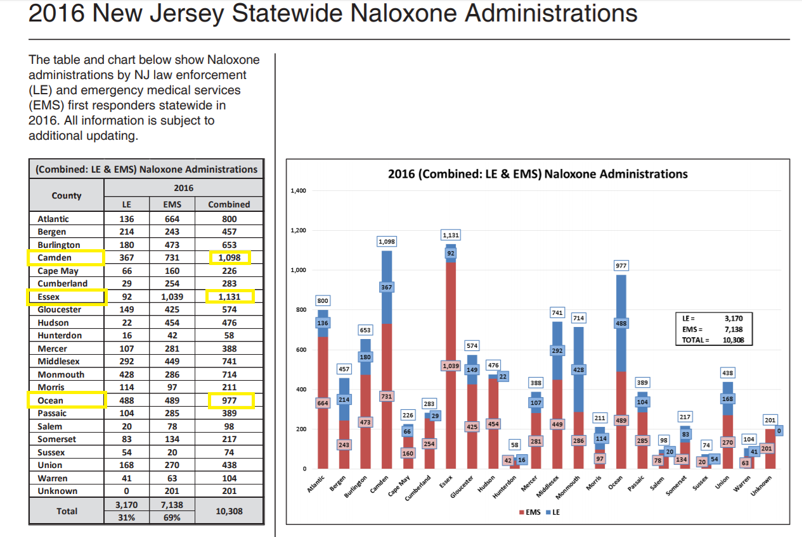

Slide 7
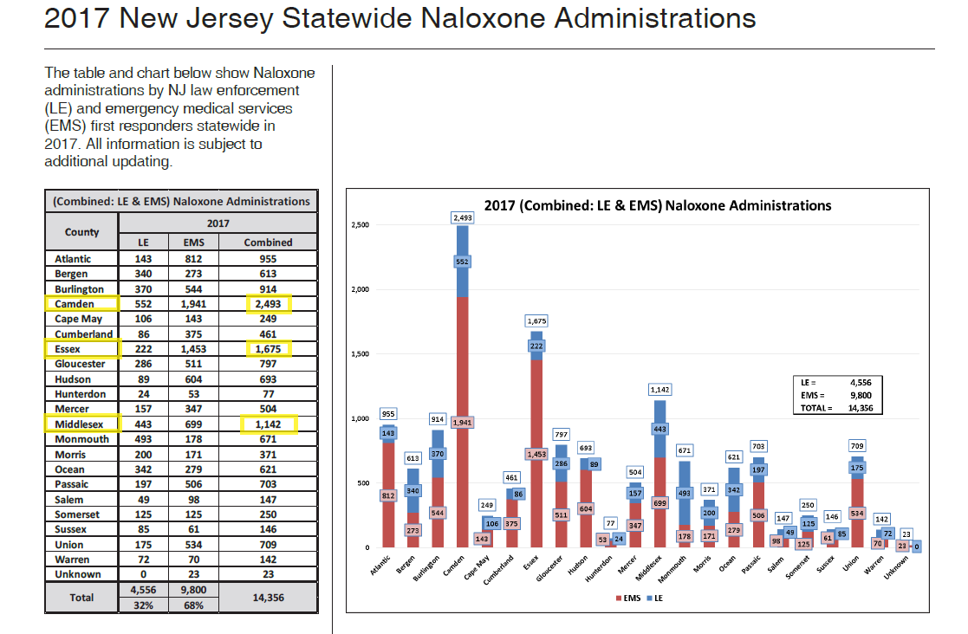

Slide 8

Mission of NJ CARES
Oversee addiction fighting efforts across Department of Law and Public Safety
Create partnerships with other agencies and groups to identify and implement solutions to the opioid crisis

Slide 9
NJ CARES Strategy:
Multi Departmental Approach
Division of Consumer Affairs
Division of Law
Division of Criminal Justice
Office of the Attorney General

Slide 10
Division of Law
Suing opioid manufacturers
Purdue Pharma (Oxycontin)
Insys Therapeutics (Subsys)

Slide 11
Division of Criminal Justice
Cracking down on drug trafficking
Pursuing criminal charges against opioid traffickers who illegally traffic heroin and fentanyl as well as diverted prescription drugs
Pursuing white collar criminals who profit from opioid diversion

Slide 12
Division of Consumer Affairs
  Cracking down on indiscriminate prescribing
  Five day limit for initial CDS prescriptions;
  Mandatory Prescription Monitoring Program (“PMP”) lookups;
  Discussions of risks and benefits with patients;
  Professional licensing boards revoking, suspending, and restricting professional licenses and CDS prescribing registration

Slide 13
Office of the Attorney General
“IDAD”
Integrated Drug Awareness Dashboard
Allows state agencies to share opioid related data
Drug busts
Overdose deaths
Opioid prescribing, as reflected in the PMP
Naloxone administrations

Slide 14
Using data to solve problems, improve patient care, and educate the public
Division of Consumer Affairs
Using PMP database to track opioid dispensing, flag problem prescribing, be alert to diversion
Enhancements to the PMP include integrating PMP data into electronic medical records, ensuring the best care for patients

Slide 15
Facilitating treatment and recovery services
Attorney General Gurbir Grewal’s program as Bergen County Prosecutor
Successfully implemented in five counties in June 2018 (Bergen, Morris, Sussex, Passaic and Union)
Grant funding to implement in every county in New Jersey by August 2019; seventeen counties expressed interest
Operation Helping Hand

Slide 16
Commitment to education
NJ CARES Website
Data on naloxone administrations, opioid prescriptions and overdose deaths
New features in coming months on naloxone, MAT, and community resources
Campaign to raise awareness about Project Medicine Drop and safe disposal

Slide 17
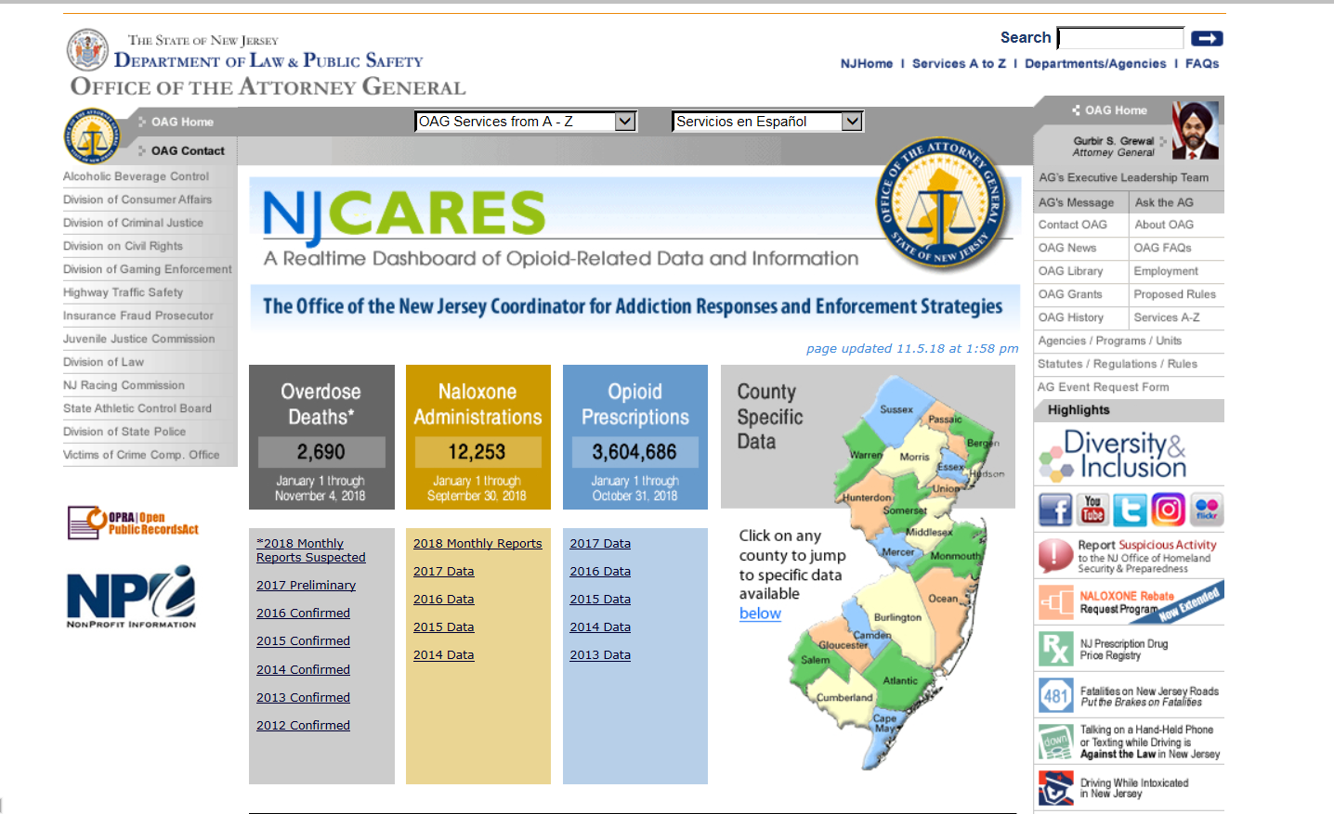
Search overdose deaths, naloxone administrations and opioid prescriptions by county on NJ CARES

Slide 18

Forging partnerships
Operation Helping Hands
Working with local law enforcement, county government, local addiction agencies
Addressing unique local circumstances
Opioid Response Teams
Utilizing municipal law enforcement, EMS, and community based peers

