Slide 1
Best Practices for
Municipal Websites
Amy Spiezio, Managing Editor
NJ State League of Municipalities

Slide 2
What’s Compliance?
New Jersey Best Practices
ADA, Section 508, World Wide Web Consortium
Making life better for your townspeople

Slide 3
Meeting Requirements
1. Ensure that government websites have accessible features for people with disabilities.
2. Provide an alternative accessible way for citizens to use the programs or services, such as a staffed telephone information line.

Slide 4
Who, Me? Yes, You!
File Creators and Document Authors- If you create files that may be distributed through email, posted online, or shared through another electronic format, you will want to know how to make your files accessible.
Supervisors- If you are responsible for managing staff, be sure they understand the importance of ensuring accessibility and have access to the training that will allow them to fulfil their responsibility for 508 compliance.
Web Managers- If you managing or developing a website, you will need to follow 508 standards for web content and monitor your 508 leaderboard score.
Project and Program Managers- If you are responsible for planning a project or managing a program, remember to allow time for 508 reviews and corrections, if necessary.
Contract Officers- If you write documentation for contracts, you should include the 508 contracting language, and ensure contractors submit 508 compliant deliverables.
Procurement Officers-If you purchase software or equipment for your office, you must follow 508 contracting requirements.
Vendors- If you do business with HHS for Information Technology products, you can reference our vendor information for product evaluation.
https://www.hhs.gov/web/section-508/who-is-responsible-for-508-compliance/index.html

Slide 5
DCA Best Practices for Websites
Municipal Websites must post:
Past 3 years adopted budgets
Current years proposed budget
Including the full adopted budget for the current year when approved by the governing body
Most recent annual financial statement and audits
Notifications for solicitation of bids and RFPs
Meeting Dates
Minutes & Agenda for:
  Governing body
  Planning board
  Board of adjustment
  All commissions

Slide 6
Why else should we Comply?
It’s the right thing to do!
6.4 million people in the United States have a visual disability.
10.5 million people in United States population have a hearing disability.
20.9 million people in United States population have a ambulatory disability.
14.8 million people in United States population have a cognitive disability.
That means that, on average, 13.2 million people in the United States have at least one disability that Section 508 is meant to help with
www.hhs.gov/web/section-508/why-comply/index.html

Slide 7
ADA Compliance
The Americans with Disabilities Act (ADA) and, if the government entities receive federal funding, the Rehabilitation Act of 1973 generally require that state and local governments provide qualified individuals with disabilities equal access to their programs, services, or activities unless doing so would fundamentally alter the nature of their programs, services, or activities or would impose an undue burden.

Slide 8
Section 508
Section 508 requires that all website content be accessible to people with disabilities. This applies to Web applications, Web pages and all attached files on the intranet, as well as, internet.
In 1998, Congress amended the Rehabilitation Act of 1973 to require Federal agencies to make their electronic and information technology (EIT) accessible to people with disabilities. The law (29 U.S.C § 794 (d)) applies to all Federal agencies when they develop, procure, maintain, or use electronic and information technology. Under Section 508, agencies must give disabled employees and members of the public access to information comparable to the access available to others.

Slide 9
W3C’s WCAG 2.1
The World Wide Web Consortium (W3C) is an international community that develops open standards to ensure the long-term growth of the Web.
WCAG: Web Content Accessibility Guidelines 2.1 (current edition)
  4 principles
    Perceivable
    Operable
    Understandable
    Robust

Slide 10
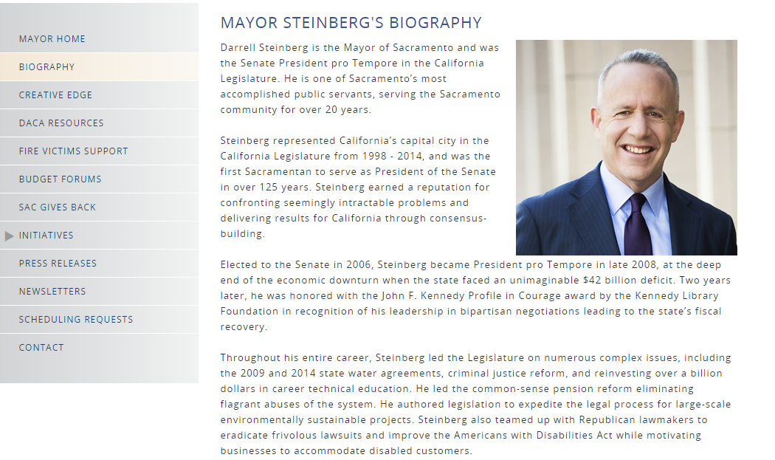
Problem/Solution #1 Unidentified images
PROBLEM: A photograph of your Mayor on the website has no text identifying it.
  Screen readers cannot interpret images unless there is text associated with it, so a blind person would have no way of knowing whether the image is an unidentified photo or logo, artwork, a link to another page, or something else.
  SOLUTION: Add a descriptive caption that provides a text equivalent of the image. “Photograph of Mayor Jane Smith.”

Slide 11
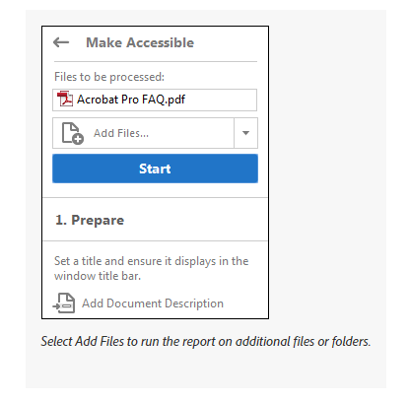
Problem/Solution #2 Accessible Forms
PROBLEM: PDF documents, or those in other image based formats, are often not accessible to blind people who use screen readers and people with low vision who use text enlargement programs or different color and font settings to read computer displays.
SOLUTION:
Check the Files: Utilize the Make PDFs accessible in Adobe Acrobat.
Post a text-based alternative such as HTML or RTF in addition to PDF

Slide 12
Problem/Solution #3 Colors & Fonts
PROBLEM: Too small fonts or too little contrast in colors may make the site unreadable.
SOLUTION: Users need to be able to manipulate color and font settings in their web browsers and operating systems in order to make pages readable.

Slide 13
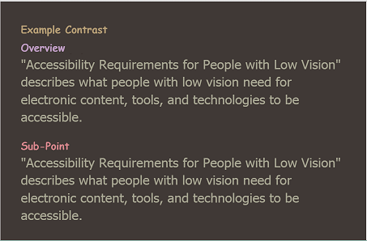
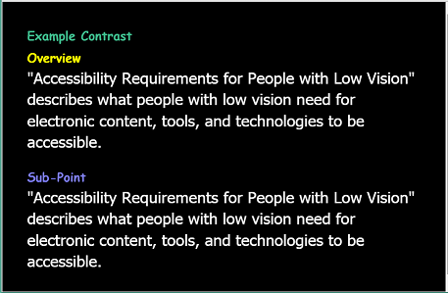
User Needs: Text
Color: Color is not the only visual means of conveying information, indicating an action, prompting a response, or distinguishing a visual element
Contrast: Selectable background and text color from the full color spectrum
Line Length: It is harder to read very long lines of text than shorter lines.
Font: Users can change the font face (also called font family or typeface) of all text, choosing from a wide range of fonts including sans serif and serif fonts.
Style: Users can change the text style (underline, italic, bold) of blocks of text.
Capitalization: Users can change the capitalization (all capital letters, small capital letters, sentence style) of blocks of text.

Slide 14
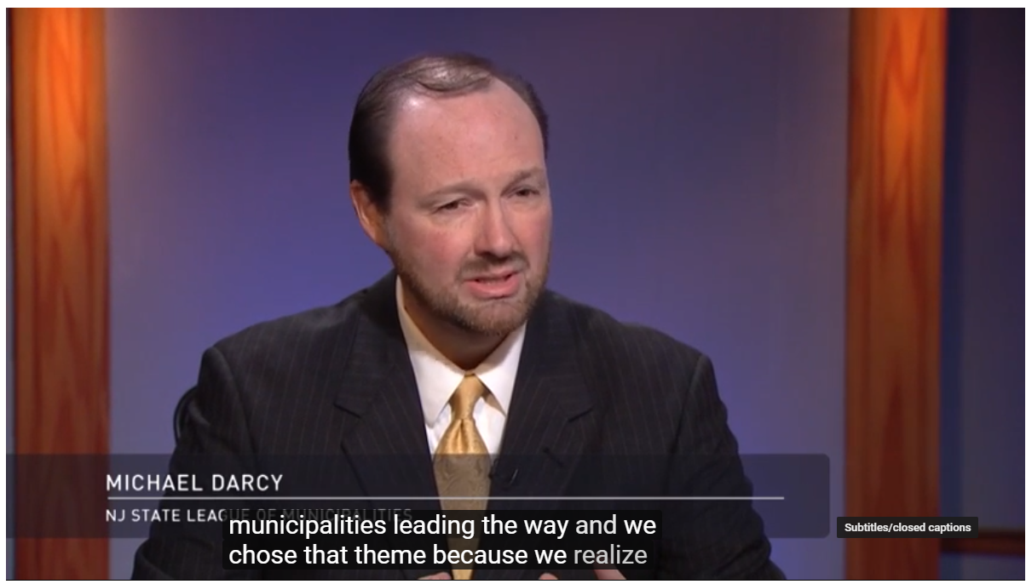
Problem/Solution #4 Audio/Visual
PROBLEM: Multimedia can present two distinct problems for people with different disabilities.
People who are deaf or hard of hearing can generally see the information presented on webpages. But a deaf person or someone who is hard of hearing may not be able to hear the audio track of a video.
Persons who are blind or have low vision are frequently unable to see the video images but can hear the audio track.
SOLUTION: Include audio descriptions and captions.

Slide 15
SO how’s your site?
Checking on what you have
Creating a plan for the future

Slide 16
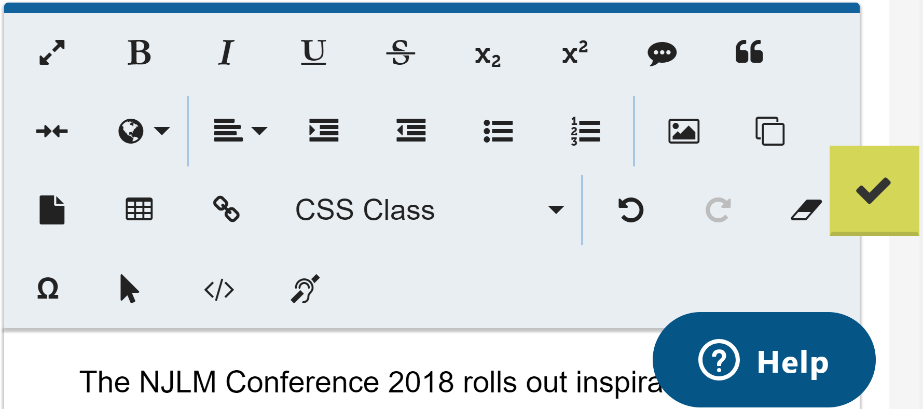

When in doubt, check it out!

Slide 17
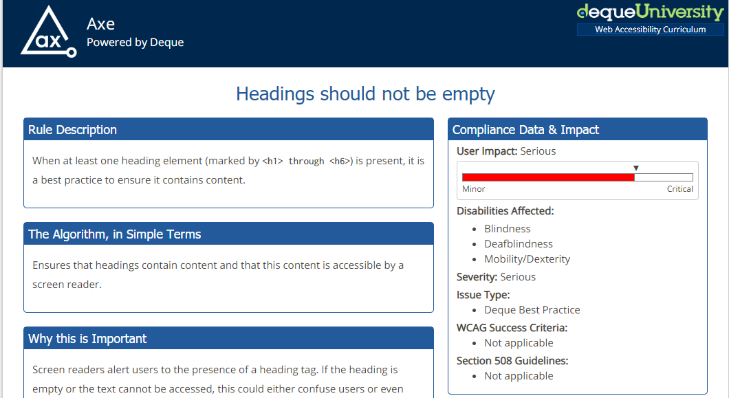
ADA Compliance in-site checker

Slide 18
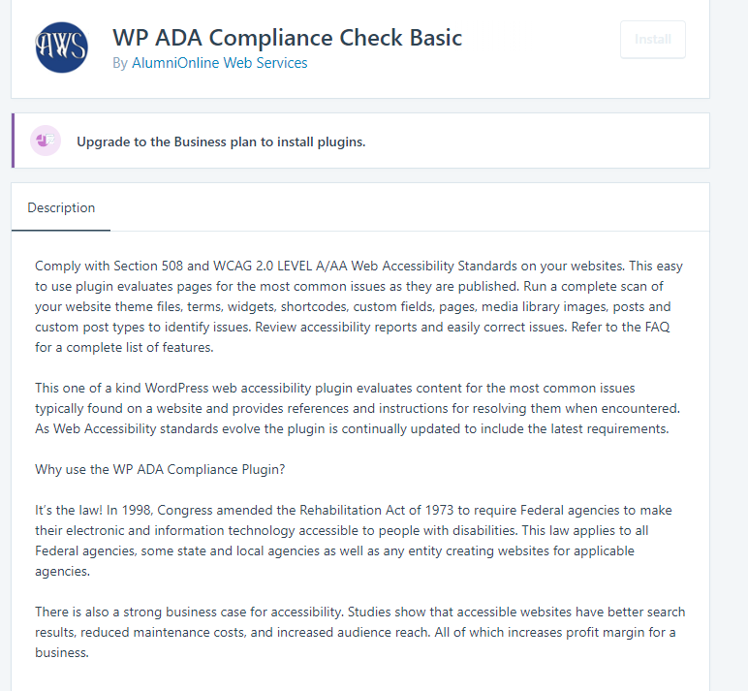
Word Press Plug In Options

Slide 19
Drupal accessibility pledge
Look for:
#D8AX - Drupal 8 Accessibility eXperience (previously #D7AX)

Slide 20
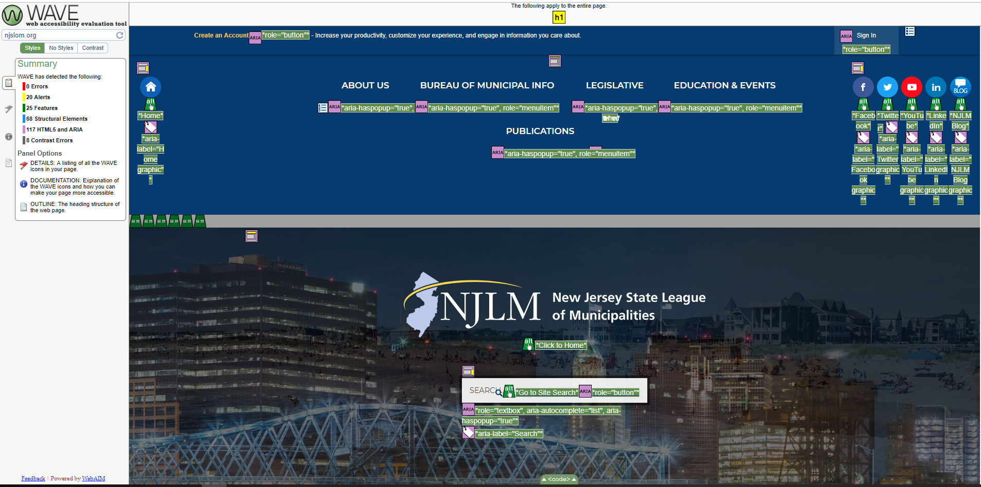
Website Accessibility Evaluation Tool: Nobody’s perfect

Slide 21
Quick checks: Your current site
Check the HTML of all new webpages/Ask your developer. Make sure that accessible coding is used.
Make sure that websites are designed so they can be displayed using the color and font settings of each visitor’s browser and operating system.
If images are used, including photos, graphics, scanned images, or image maps, make sure to include a text equivalent, by adding “alt” tags or long descriptions, for each.
If you use online forms and tables, make those elements accessible by labeling each control (including buttons, check boxes, drop-down menus, and text fields) with a descriptive HTML tag.
When posting documents on the website, always ensure they are accessible versions.

Slide 22
Developing a Plan
Establish, implement, and post online a policy that your webpages will be accessible and create a process for implementation.
Ensure that all new and modified webpages and content are accessible (see Quick Check list).
Plan to fix what’s broken
Remember to keep updating accessible features as you update webpages.
Train your people. www.ada.gov
Provide contact points for visitors on home page for those who can’t work with your site.
Periodically enlist disability groups to test your pages.
Don’t forget, there are people who don’t have access to computers. Keep the information available in other forms, too.

Slide 23
Resources
“Accessibility of State and Local Government Websites to People with Disabilities,” a technical assistance document released by the Department of Justice in 2003
www.access-board.gov, the website of the Architectural and Transportation Barriers Compliance Board (known as “the Access Board”), which establishes the standards used by the federal government to ensure that its electronic and information technology is accessible to people with disabilities;
www.section508.gov, the website of the Federal Information Technology Accessibility Initiative;
www.ittatc.org, the website of the Information Technology and Technical Assistance Training Center;
www.cast.org, the website for the Center for Applied Special Technology, a nonprofit, educational organization working to expand educational opportunities for all, including individuals with disabilities, through technology;
1-800-949-4232 (voice and TTY), the ADA and IT Technical Assistance Centers (www.dbtac.vcu.edu).

