Slide 1

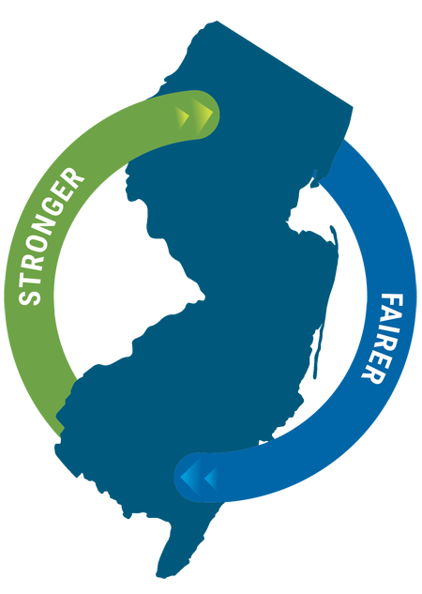
Max Frank Senior Project Officer Gardenstatecpace@njeda.gov

Slide 2
C-PACE Basics
A loan program targeting clean energy and resiliency-related improvements in commercial buildings.
40+ C-PACE programs throughout more than 30 states.
Private lenders are the source of capital. No public dollars.
The financing is similar to a second mortgage with a few key differences:
The repayment is collected as an addition to the property tax payment on the property;
The loan is senior to any other mortgage on the property;
In the event of a change in ownership or some event of default: the C-Pace loan does not retire, but rather stays attached to the property and continues to be paid by the next owner;
These factors reduce the risk of the loan and allow the private lender to: lend for a longer term, lend at a lower interest rate, and lend a larger proportion of the total project cost.
2

Slide 3
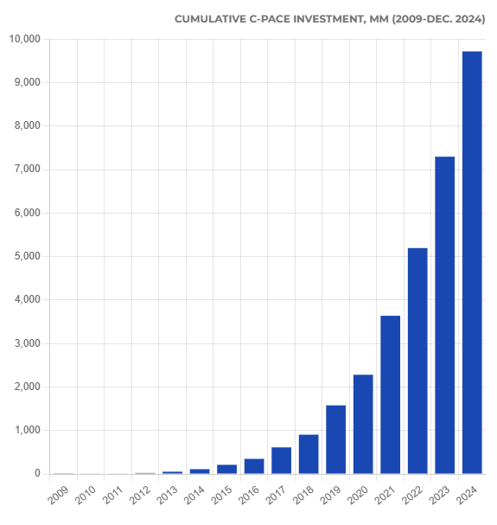
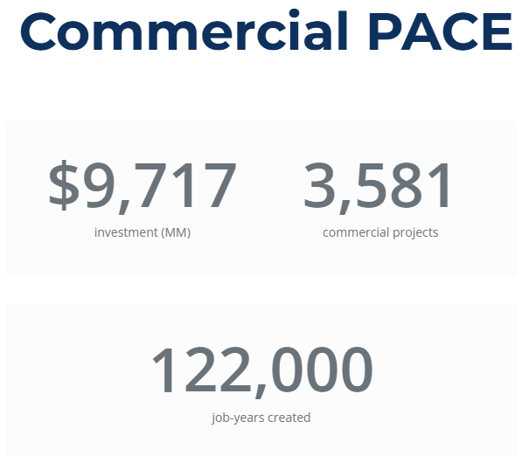
National Market Data - through 2024
$2.42B in 2024
PACENation.org

Slide 4








Garden State C-PACE Eligible Projects Eligible Projects must be affixed to an Eligible Property
Energy Efficiency
Renewable Energy Systems
EV Charging Infrastructure
Energy Storage
Water Conservation
Hurricane Resistance Construction
Flood Resistant Construction
Stormwater Management Systems
4

Slide 5
Program Eligibility
Requirement | Description
Eligible Property | Located within a Participating Municipality – requires Municipality Opt-In Must be property other than single-family residential or multi-family
Eligible Costs | Direct Costs and Indirect Costs, including financing and program fees
C-PACE Financing Terms | Program covers up to 100% of project costs Term up to 30 years Must obtain Mortgage Holder Consent Terms solely determined and negotiated between the Eligible Owner and Capital Provider
5

Slide 6
Repayment Process
Reminder:
This is 100% private capital
Private Capital Provider
Provides up-front capital for Eligible Projects
Property Owner
Flow of Money
Makes regular payments for Eligible Projects through an assessment placed on property
Municipality
Collects and remits payments to capital provider

Slide 7




Program Participants – Responsibilities
Program Participants
Municipality
Capital Providers
Technical Evaluator
Technical Reviewer
Must opt-in to program and agree to collect and remit money
Provides financing
Manages the process for project applicant
Performs technical work
Advises project scope and design
Ensures technical eligibility
Certifies building energy efficiency performance
7

Slide 8

Program Participants - Benefits
STAKEHOLDER BENEFITS
Get longer term financing
Lower interest rates
Smaller debt service payments make it much easier for projects to pencil out
No recourse to business owners—no personal guarantees
Changes the conversation in context of voluntary transfer of property
Off-balance sheet accounting treatment
Opportunities, without a funding outlay, to:
Support measures that will reduce greenhouse gas and criteria pollutants emitted by their C&I sector
Support resiliency measures that could be of critical importance to local businesses
Enhance the tax base due to property improvements and new construction projects
Boost local economic development
Increasing comfort level with consenting to C-PACE loans
They can see the enhancement of the value of their collateral
Lack of ability to accelerate C-PACE financing is critical
Unique feature means that the magnitude of C-PACE payment defaults remain manageable
Mortgage lenders are entering the market!
Helps contractors better convert leads to deals for energy upgrades by giving property owners access to up to 100% up-front financing for up to 30 years
Allows for deeper energy efficiency, renewable energy, and resiliency improvements because of increased affordability for borrowers
Offers capital providers extremely strong loan security position similar to a tax lien on a property, which sits in a senior position to other encumbrances on the property
Garden State Program is “open platform” —meaning that any capital provider that meets certain basic requisites may participate
Property Owners
Municipalities
Mortgage Holders
Contractors
Capital Providers
8

Slide 9
The Ask
Become a Participating Municipality:
Adopt the C-PACE Program Opt-In Ordinance
Enter into the Program Agreement with NJEDA
Why?
There’s no sign-up cost
All documents are pre-drafted
Enabled to recoup up to $1,250/project per year for administrative costs
One-Time action, not per project
9

Slide 10
Thank you Gardenstatecpace@njeda.gov www.njeda.gov/c-pace/

